Slide 1
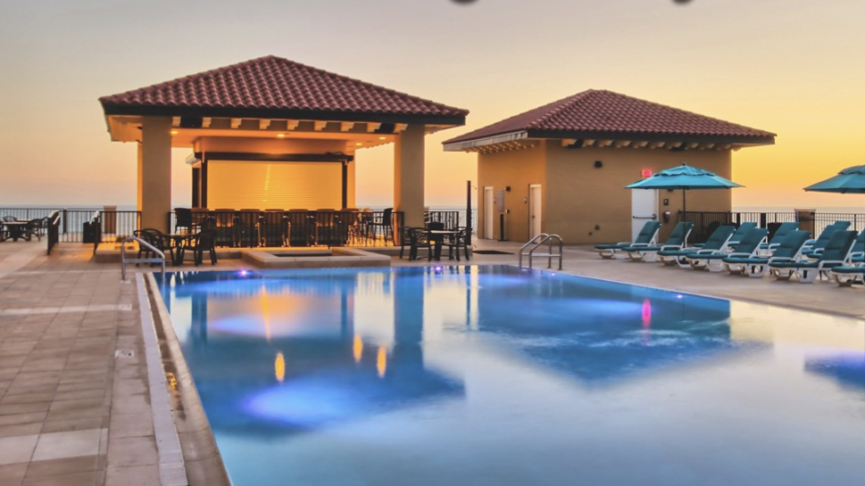
Riverstone event management

Slide 2
PROBLEM STATEMENT
People who are planning for a vacation, will look for a resort which provides various amenities along with a good resort.
Hotel Management usually concentrates only on managing bookings of the room and do not take care of other recreational events
To help clients find their best time with events like catering, entertainment, resort and other features we have created an application called RIVERSTONE EVENT MANAGEMENT

Slide 3
APPROACH
To create a centralized platform for to book rooms, manage events, manage resorts, manage music and manage catering
Users can request for a room, select a trainer, physician or therapist of their choice. Event Manager will organize parties, weddings and photography sessions. Resort Manager will manage the lounge and car services. Catering Manager will check on Delivery agent. Music Manager will organize DJs, Live singing and Jazz

Slide 4

AREAS TO FOCUS
1) Resort Management will help to enhance their resort features keeping in mind the demand
2) Customers demand will always be our main concern and we will be focusing on providing the right resources to our customers
3) Event Manager will take care on the important activities related to parties, weddings etc. and give the best deal to customers

Slide 5
THANK YOU
- Pavithra Ram Kumar (NUID-002929680)
- Aishwarya Wagdarkar (NUID-002964461)
- Satya Sowri Sampath Korturti (NUID-002926129)

